Slide 1
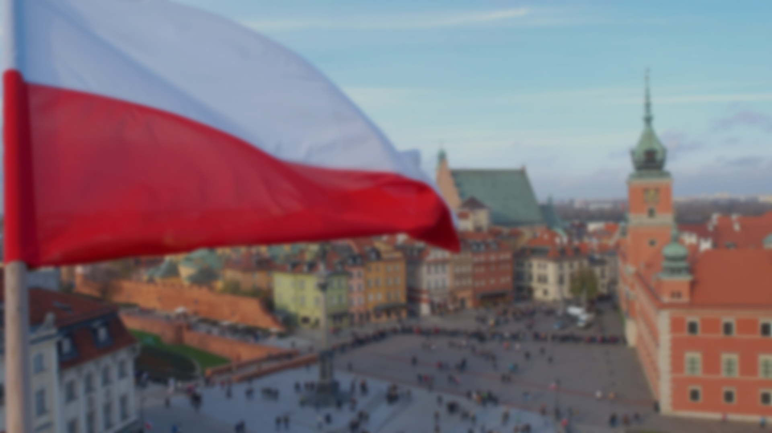
Poland Sectors of the Economy
Prepared by: student 3E2 Podstrechny A.V.
Checked: FEA teacher Perelman M.A.

Slide 2
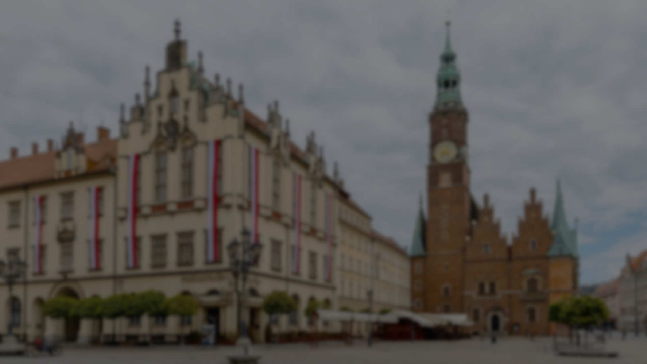
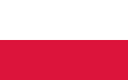
Table of contents
Introduction
Sectors of the Economy
The largest companies in each sector
The number of workers (employees)
Conclusion

Slide 3



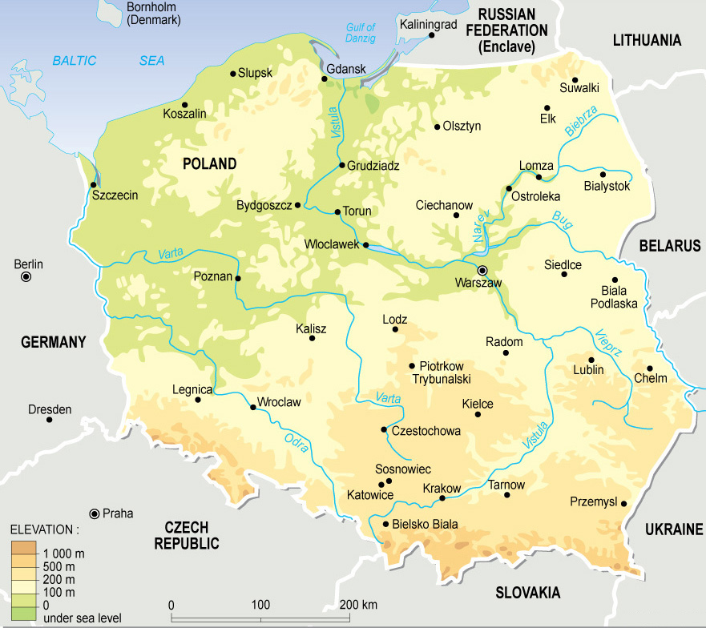


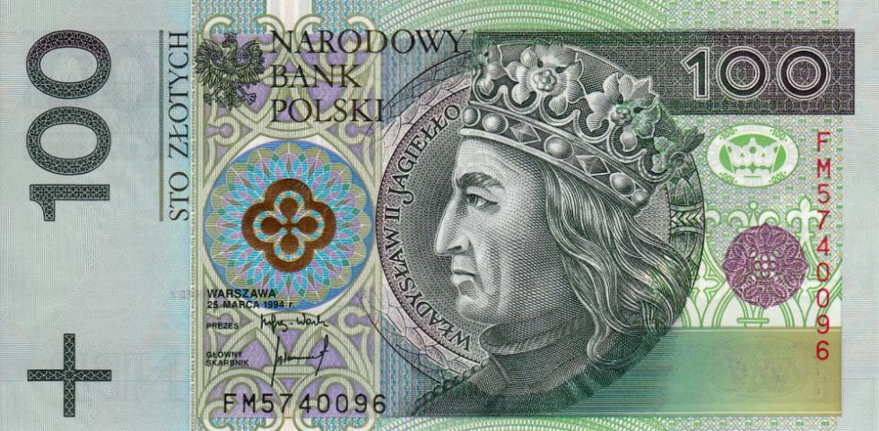
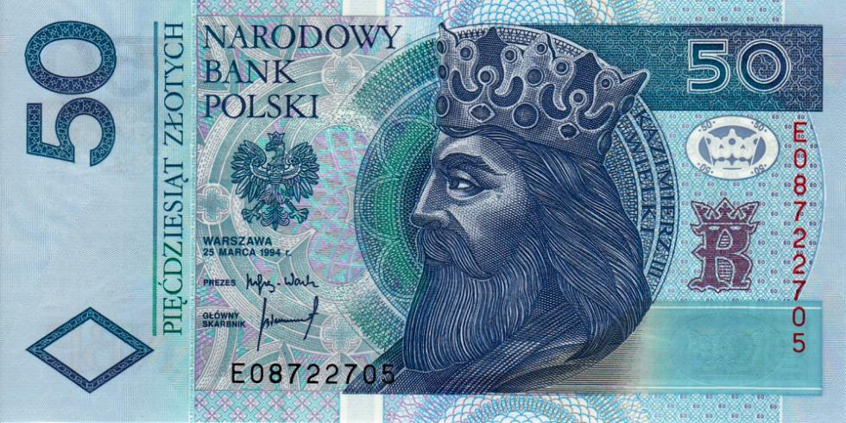
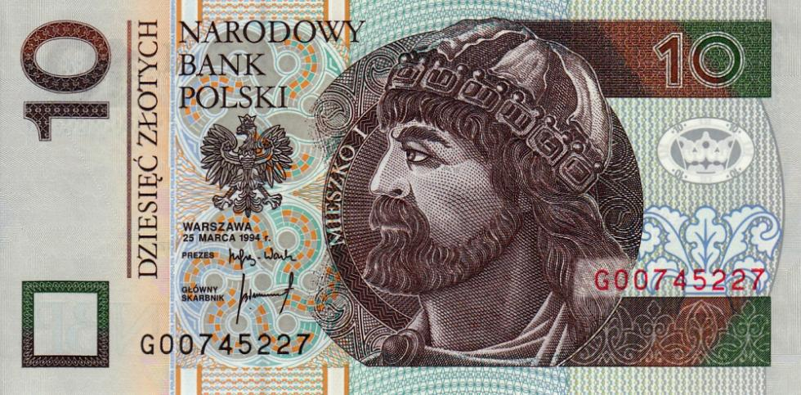
Introduction
Poland is a large country located in Central Europe. With its rich history, cultural heritage and rapid economic development over the past decades, Poland has become one of the key economies in the region. The capital of the country is Warsaw and the official language is Polish.

Slide 4
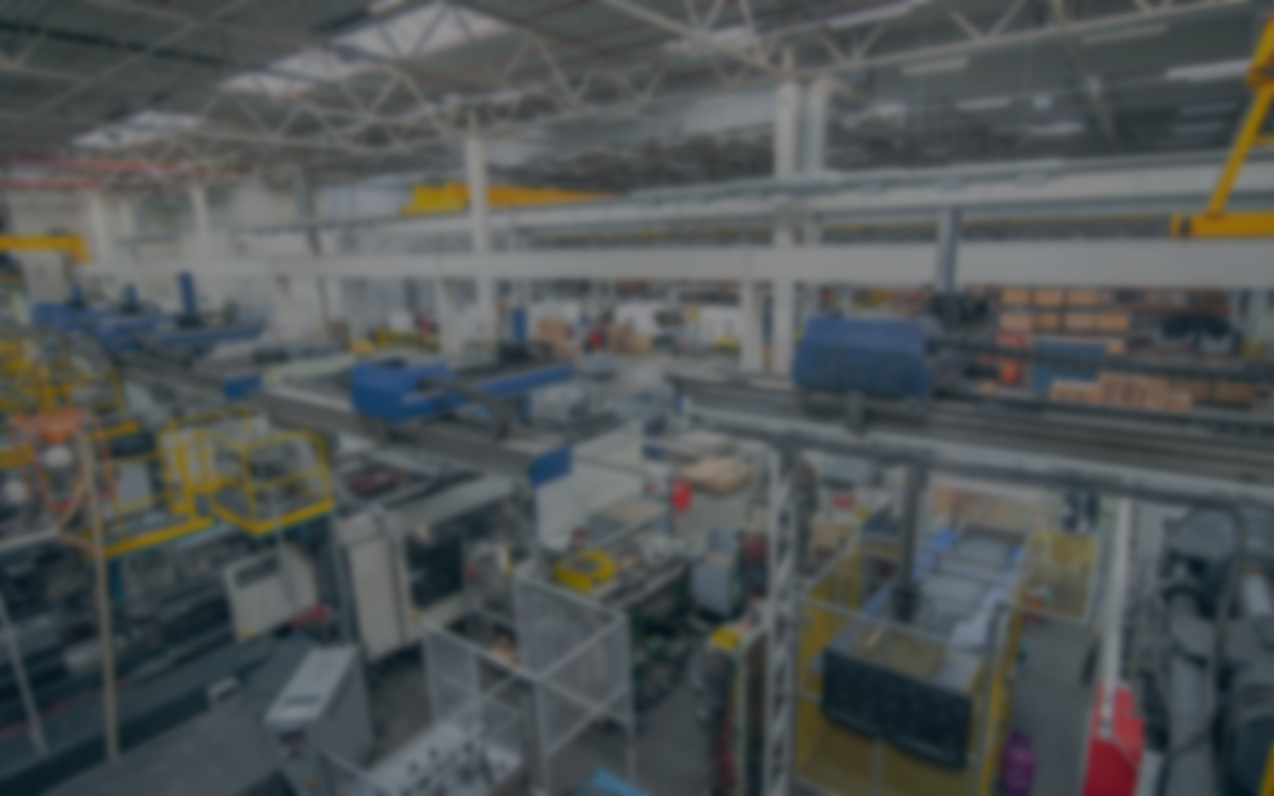
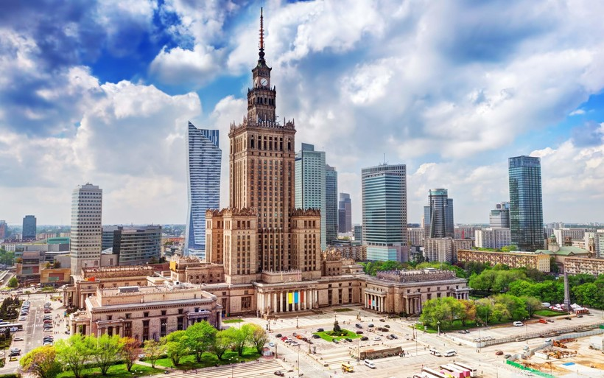
Sectors of the Economy
Poland has a very diverse economy. In its structure, the sectors of the economy known to us - primary, secondary, tertiary, quaternary and quintessential sectors - are fully represented. The country has a thriving service sector, livestock breeding, management of international organizations and IT-technology. Next, let us look at examples of companies engaged in the above sectors.

Slide 5






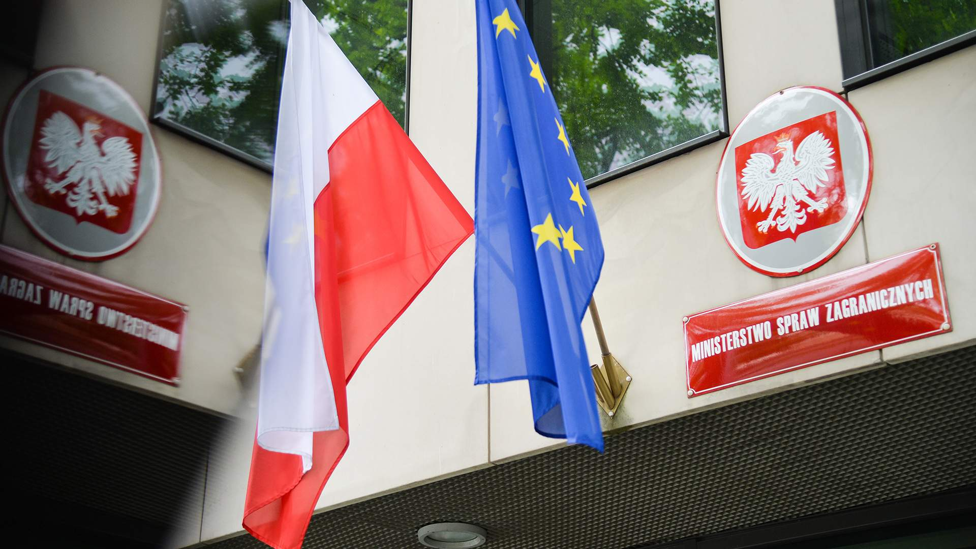

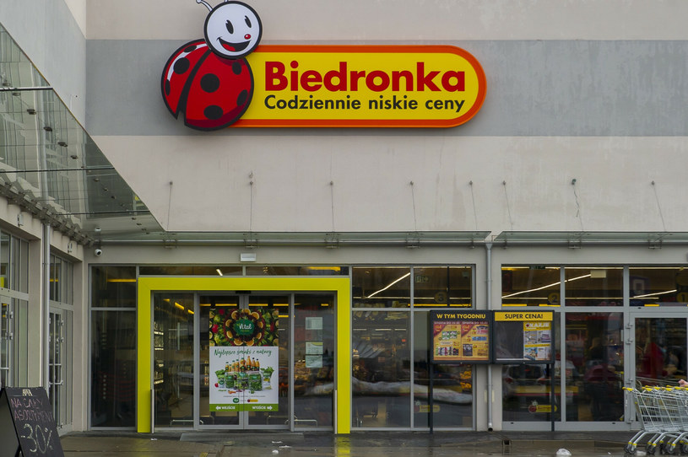




The largest companies in each sector
Primary sector:
Agros Nova;
Polski Cukier.
Secondary sector:
PGE Polska Grupa Energetyczna;
PKN Orlen.
Tertiary sector:
PKO Bank Polski;
Biedronka;
Lidl.
Quaternary Sector:
CD Projekt;
Sabre.
Quinary Sector: World Policy

Slide 6

Number of working people in the sectors
Primary sector: About 11% of the working age population is employed in the primary sector.
Secondary Sector: About 30% of the population is employed in the secondary sector.
Tertiary Sector: Nearly 59% of the population is employed in the tertiary sector.
Quaternary Sector: About 2% of the labor force is employed in the fourth sector.
Quinary Sector: The fifth sector covers a small proportion of the population and includes the highest levels of government and political positions.

Slide 7

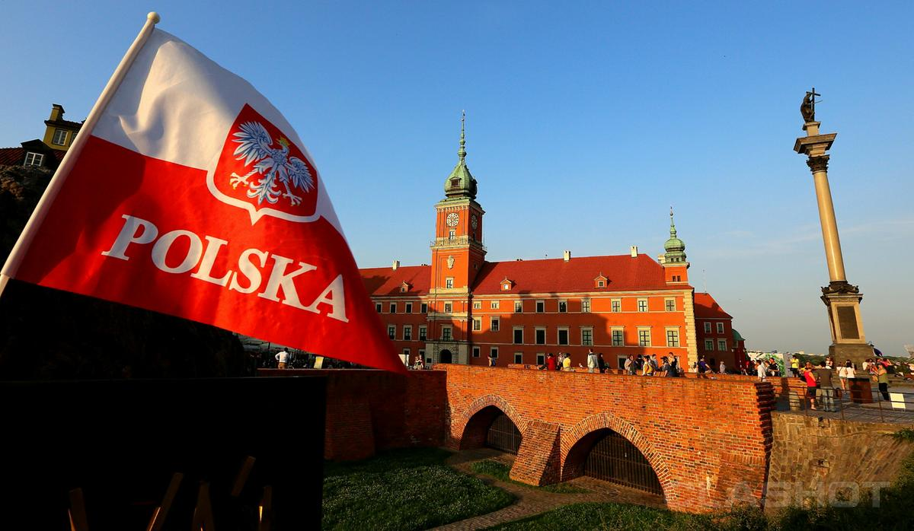
Conclusion
In conclusion, Poland is an economically diverse country with developed agricultural, industrial and service sectors. Large companies and innovative start-ups are actively investing in the country's economic growth. An even distribution of the labor force between different sectors contributes to Poland's sustainable development and prosperity.

Slide 8
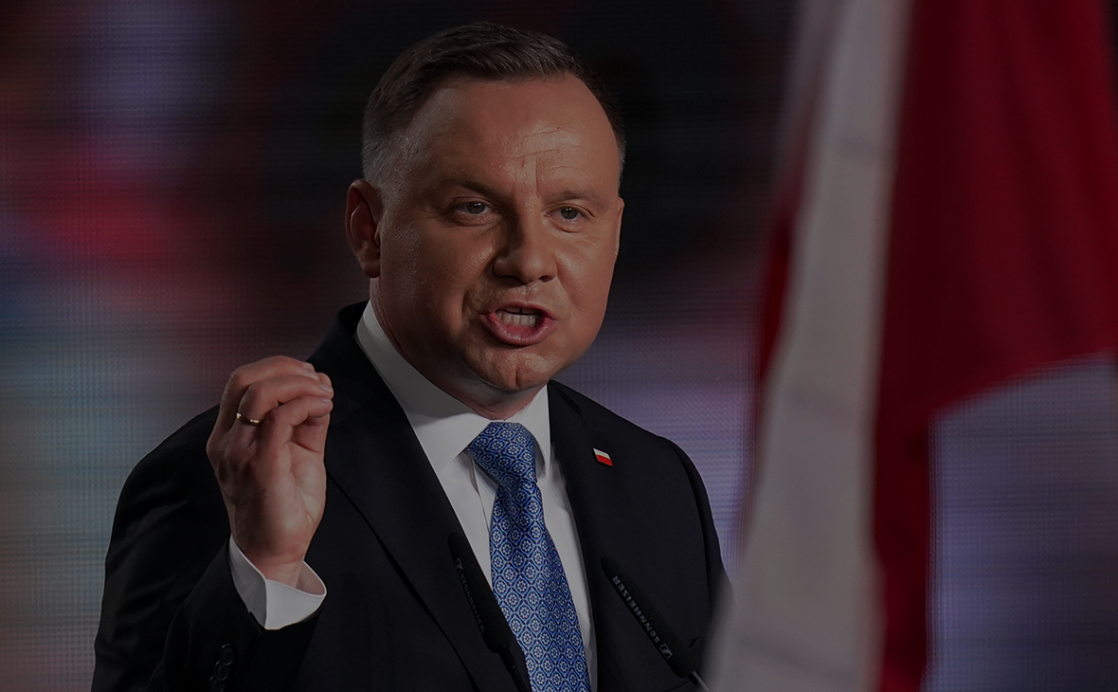
Thanks for your attention!

